Slide 1
3DIMD and XR Multimodal Interaction
5MMCS007W/5CCGD013W Lecture 10
Unity Physics /Collision
https://www.blend4web.com/apps/dairy_plant/dairy_plant.html?v=93906d9bd04fe610df690c519724295f
https://www.youtube.com/watch?v=gwYjnWCcw18

Slide 2
3DIMD and XR Multimodal Interaction
Unity UI Physics, Collision and Triggering

Slide 3
3DIMD and XR Multimodal Interaction
GameObject Dynamics Options
https://www.youtube.com/watch?v=xp37Hz1t1Q8

Slide 4
3DIMD and XR Multimodal Interaction
Static - No Movement, no Effects (Static ticked)
Kinematic RigidBody (RigidBody, IsKinematic, Static Not ticked)
Can be moved, no forces affect it
It can affect Dynamic RigidBody Game Objects
Unity Transform (Translate, Rotate, etc.) to move it
Dynamic RigidBody (RigidBody, No IsKinematic, Static Not ticked)
All forces affect it and other Game Objects
Unity Physics (addForce) to move it
Gravity (can be on or off)

Slide 5
3DIMD and XR Multimodal Interaction
Unity Collisions and Triggers

Slide 6
3DIMD and XR Multimodal Interaction
Unity Collisions and Triggers
Collision Detection - Needs:
Collider Shape – can be edited to taste
IsTrigger in Collider Off
OnCollisionEnter(Collision Col)
Trigger Detection – Needs
Collider Shape – can be edited to taste
IsTrigger in Collider On
OnTriggerEnter(Collider Other)

Slide 7
3DIMD and XR Multimodal Interaction
Unity Collider and Trigger Matrix

Slide 8
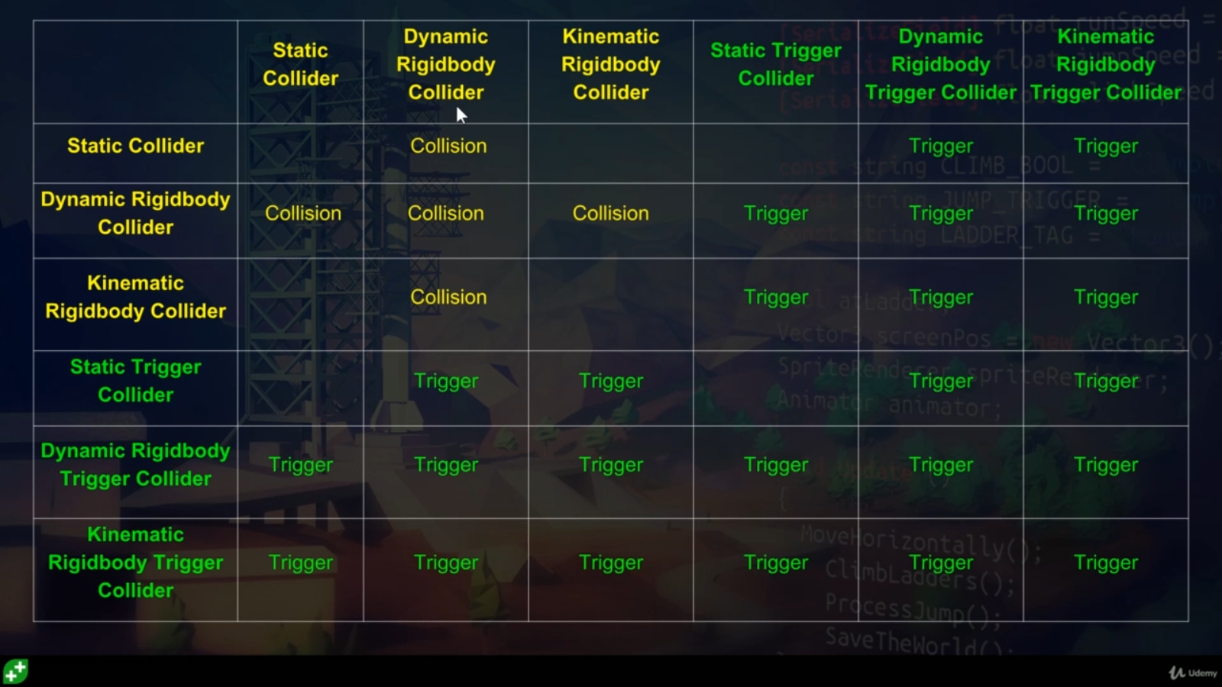
3DIMD and XR Multimodal Interaction

Slide 9
3DIMD and XR Multimodal Interaction
Unity Collisions for Triggers

Slide 10
3DIMD and XR Multimodal Interaction
Unity Collisions for Triggers Does not "Collide", detects intersection for trigger
Needs: Collider Shape and Script for Trigger Detection - OnTriggerEnter(Collider other)
Dynamics: Objects can be Static or Non Static (Animated, Scripted Movement, no Physics)
Static Collider – cannot have two!
Static Trigger Collider
Collider
Trigger Collider
Trigger Collider
IsTrigger On = Objects Now Pass through, needs overlap, not collision !
Detects if another collider entered
IsKinematic RB Collider to IsKinematic RB Collider do not need IsTrigger On
Moving a static object will give unwanted results
Script: Use OnTriggerEnter(Collider other) to perform functions upon detection

Slide 11
3DIMD and XR Multimodal Interaction
Unity Collisions again

Slide 12
3DIMD and XR Multimodal Interaction
Unity Collisions
Collider hitting Rigid Body/Collider (for Collision Detection)
This is true Collision Detection, not Triggering in slide above
Collision and Physics: OnCollisonEnter(Collision col)
RigidBody enables a collision - Solid
True RB - should only move by forces - ideal situation
IsKinematic RB, or No RB can use movement scripting
IsTrigger Off enables a collision - Solid

Slide 13
3DIMD and XR Multimodal Interaction
Unity Collisions
Collider hitting Rigid Body/Collider (Collision Detection)
This is true Collision Detection, not Triggering in slide above
Gravity - on off
Static - No Movement, no effects
Is Kinematic - Can be moved, no forces affect - on off
IsKinematic On - Use Transform
Dynamic - Physics, Rigid Body - all forces affect it and others
Controls whether physics affects the rigidbody.
IsKinematic off - Use forces
Collision and Physics:
https://www.youtube.com/watch?v=S0MXZ6AXzTE

Slide 14
3DIMD and XR Multimodal Interaction
Unity Collisions Dynamics Options
Game Objects with RigidBody, Collision:
Static – no movement, no effects
Gravity On - Will fall
Gravity Off, IsKinematic Off
Acts as Static, but forces affect
Kinematic: IsKinematic on, Gravity on
May be moved, but not affected by forces
Compare to Static collider: SC Is not calculated for – optimised
Is Kinematic cancels out Gravity
Kinematic: IsKinematic On, Gravity Off
Acts as static, but is real collision
Dynamic: IsKinematic Off, Gravity On or Off
Uses Forces

Slide 15
XR Multimodal Interaction
Linking it to XRIT…
A Rigidbody is required for an object to be grabbable using the Unity XR Interaction Toolkit (XRIT) XRGrabInteractable component.
Automatic Addition: When you add an XRGrabInteractable component to a GameObject, Unity will automatically add a Rigidbody component if one is not already present.

Slide 16
XR Multimodal Interaction
Key Movement Types for XRIT Rigidbody Handling…
XRGrabInteractible: Rigidbody behavior during interaction
Instantaneous
Direct movement by setting transform each frame
Kinematic
isKinematic while grabbing, moving via Rigidbody.MovePosition
Velocity Tracking
Calculates velocity/angular velocity to move the object via physics – can push other objects without lagging behind the hand

Slide 17
XR Multimodal Interaction
Linking it to XRIT…
Purpose: The Rigidbody handles physics simulation (gravity, falling, collisions) when the object is released or thrown.
Kinematic Handling: While grabbed, the XRGrabInteractable often sets the Rigidbody to be Kinematic (i.e., isKinematic = true). This tells the physics engine that the object's movement is driven by the VR controller's position, not by forces like gravity.
Alternatives: If you use the "Instantaneous" movement type, the object follows the hand transform directly, but it generally still requires a Rigidbody to interact properly with the XR interaction system's collision detection.
Essential Setup for Grabbable Objects:
Collider: To define the collision boundary and allow interaction.
Rigidbody: For physics behavior.
XR Grab Interactable: To handle the grabbing logic.
It is highly recommended to ensure the Collider is not set to "Is Trigger" unless you have a specific reason to do so, as this affects collision detection.

Slide 18
3DIMD and XR Multimodal Interaction
Unity Collisions
Collider hitting Rigid Body/Collider (for Collision Detection)
This is true Collision Detection, not Triggering in slide above
Collision and Physics: SHORTCUT
Shortcut
Kinematic RB Trigger Colliders - transformed to move
True RB - Addforce
Movement Scripting

Slide 19
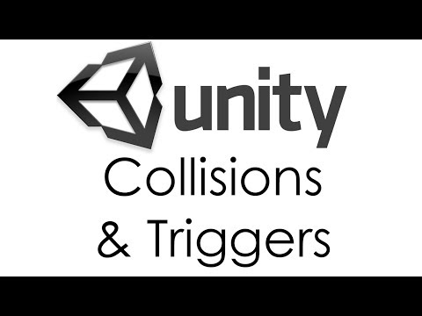
3DIMD and XR Multimodal Interaction
Unity Collisions and Triggers

Slide 20
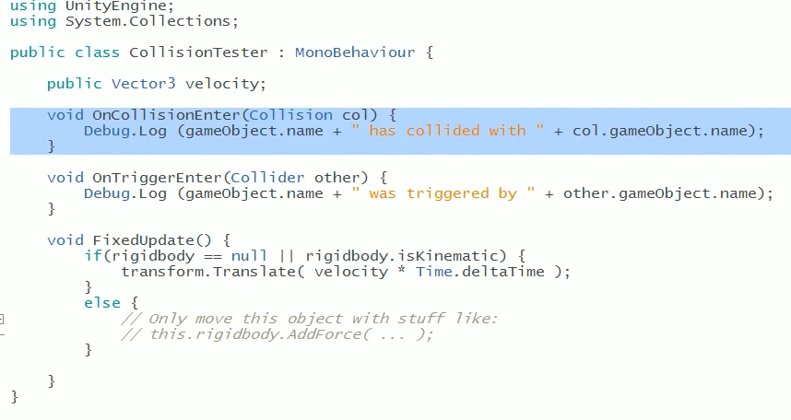
3DIMD and XR Multimodal Interaction
Unity Collisions and Triggers Test Project
https://www.youtube.com/watch?v=WFkbqdo2OI4

Slide 21
3DIMD and XR Multimodal Interaction
Unity Collisions and Triggers Test Project
https://www.youtube.com/watch?v=WFkbqdo2OI4
Demo:
Make Cube and Sphere - have colliders - play - nothing, can move, but is bad (unoptimised) essentially static, even if not ticked
RB on ball - real and physical - gravity and Collision with cube - physics engine - may just need trigger
Add script to both - 90% just need triggers
Collision or trigger notifies both objects
Collision: When True RB hits collider (not trigger)
Try box with and without IsTrigger and look at console
Turn box non-static (RB) - add RB, has gravity, will fall - turn off gravity - then collision moves it
Turn Box into IsKinematic - Box not moved - IsKinematic (may be moved - no Physics) vs Static (will never move - 0ptimised)
Turn Sphere to IsKinematic - no movement, but dragging - they do not affect each other
IsKinematic RB with IsTrigger

Slide 22
3DIMD and XR Multimodal Interaction
Character Controller Overview (Extra)
3 Options
How to Move Characters In Unity 3D | Character Controllers Explained
https://discussions.unity.com/t/character-controller-vs-rigidbody/909343/5
Non-RB custom (Unity CC) - not good with physics
Dynamic RB
Kinematic RB
Physics (dynamic or kinematic RB)
Making A Physics Based Character Controller In Unity (for Very Very Valet)
https://discussions.unity.com/t/rigidbody-3d-platformer-controller-condfused/847979
Platforms:
Simple Moving Platform Setup Rigidbody/Character Controller - Unity Bolt Tutorial |Visual Scripting
After more than 4 hours stuck with this video + Character controller, I will only say this: Edit -> Project Settings -> Physics (or Physics 2d) -> Auto Sync Transforms
From <https://www.youtube.com/watch?v=2MkNoaWJWf4>
the trigger must not intersect main collider on the platform.
From <https://www.youtube.com/watch?v=2MkNoaWJWf4>
Basic: parent character transform to new platform when platform collider triggered
How to Create 3D Moving Platforms (Unity Tutorial)
https://discussions.unity.com/t/charactercontroller-on-a-moving-platform/684563/7
https://discussions.unity.com/t/how-to-get-a-character-to-move-with-a-moving-platform/1720

Slide 23
3DIMD and XR Multimodal Interaction
Software Architecture
Forefront

